Slide 1
Implementation of symmetric algorithm modification system to resist power based side channel attacks

Slide 2

What is a ‘Side Channel attack’ ?

Slide 3
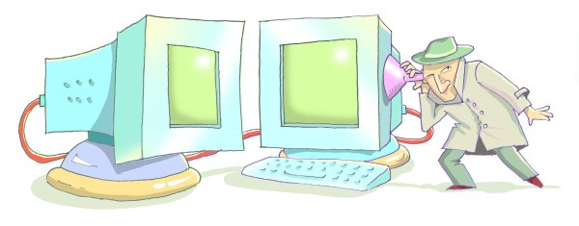

Slide 4
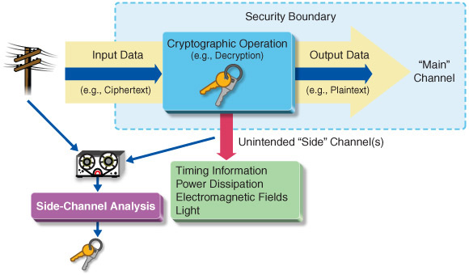
Side Channel Attack is ..
Any attack based on information gained from the physical implementation of a cryptosystem, rather than brute force or theoretical weaknesses in the algorithms.

Slide 5
Side Channel Attack is .. (Cont..)
These attacks based on “Side Channel Information “. Side channel information is information that can be retrieved from the encryption device that is neither the plaintext to be encrypted nor the ciphertext resulting from the encryption process.
That Side Information can be ,
Timing Information
Electromagnetic Radiation
Power consumption
Thermal Radiation
Acoustic Emanation

Slide 6

Why this Research Based On ‘Power Consumption’ ?

Slide 7
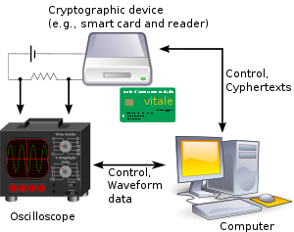
One of the most effective and powerful methods.
Most frequently used method to collect side-channel-information by attacker and intruders
Considered as one of the most reliable side-channel-information sources
Most cost effective when compared with other methods of information gathering

Slide 8
Why this research based on Symmetric algorithm
Encryption and Decryption operations utilize same key
Typically more efficient than Asymmetric encryption
Used to bulk data encryption
Well known symmetric algorithms : 3DES, AES, Blow Fish, Mars, RC2, RC4

Slide 9
Up to Now..
There are devices that are designed to gather side-channel-information.
Can analyze side channel information to perform an attack.
Have the capability to derive the key through the attack.

Slide 10
Up to Now.. (Cont.…)
SASEBO (Side channel Attack Standard Evaluation Board)
CHIP WHISPERER
SAKURA-G FPGA

Slide 11
Problems Identified ..
There is no any product to find the vulnerable points in algorithm by analyzing power spike patterns.
There is no process to patch it automatically without altering the algorithm in order to mitigate side channel attacks.

Slide 12
How can we mitigate side channel patterns?

Slide 13

Solution
Adding “RANDOMNESS” to the algorithm

Slide 14
Extracting power consumption measurements
Implementing a device to extract power consumption information
Based on Arduino and FPGA board.
Implementing an algorithm to take power consumption information into digital format and input to PC.
Filtering the gathered information by removing noise to get more accurate readings.

Slide 15
Data classification, analysis and module training
Preprocessing extracted data to create an ideal dataset
Transforming preprocessed data into appropriate machine learning styles
Identifying patterns in the dataset
Utilizing performance of the applied process

Slide 16
Automate Code embedding mechanism
Identifying exact location in the code according to identified pattern.
Uses machine learning techniques.
Adding required code to the algorithm automatically.

Slide 17
Overall Idea

Slide 18
Milestones
Investigating ideal hardware parts according to the requirements.
Analyzing required algorithms used in supervised and unsupervised learning styles
Analyzing techniques to add random code segments automatically.
Implementing fundamental hardware device with partially designed analyzing system

Slide 19
Evaluation
Testing the accuracy of the initial readings by comparing with freely available power consumption information
Obtaining results for publically available symmetric encryption algorithms
Testing the implemented solution using customized symmetric algorithms.
Running finally patched code through the system or examine whether its still capture any patterns
Testing implemented code solutions through commercialized products (optional)

Slide 20
Benefits
Cost Effective
Less complexity – can be use by any person who doesn’t have knowledge in cryptology
Cryptographic algorithms can be strengthened against side channel attack.

Slide 21
Capturing the Market
Free and open source at the initial stage
Use social media to promote

Slide 22


Slide 23

Questions ?

